Slide 1

Chapter 5:
Steady Electric Currents
Lecturer: Nana Liu
Summer 2020
Many slides courtesy of Sung-Liang Chen

Slide 2
Everything you need to know
about steady electric currents
in this course…

Slide 3

Static electric charge density
Electric field

Slide 4
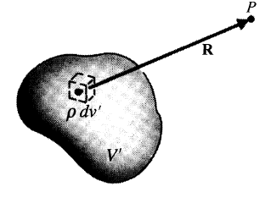

Static electric charge density
Electric field

Slide 5
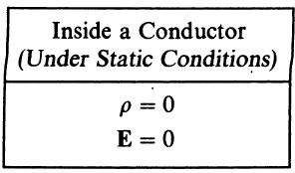
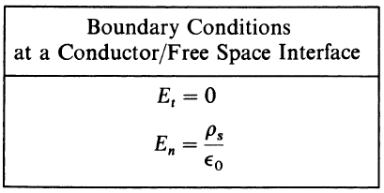
Static electric charge density
Electric field

Slide 6
Electric current density
Electric field density ?

Slide 7
Electric current density
Electric field density ?
Deriving Ohm’s Law:
Relating speed, current, resistivity/conductivity

Slide 8
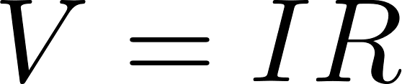
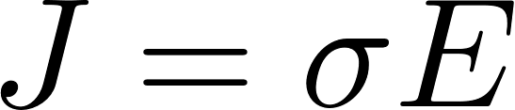
Electric current density
Electric field density
Deriving Ohm’s Law:

Slide 9
Currents in closed loops
Conservation laws

Slide 10
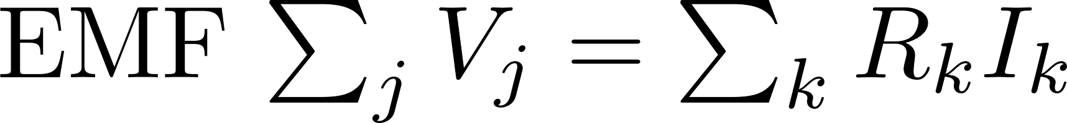
Currents in closed loops
Kirchoff’s voltage law
(loop analysis)

Slide 11
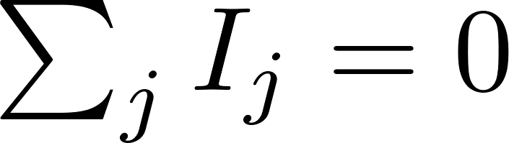
Currents in closed loops
Kirchoff’s circuit law
(node analysis)

Slide 12
Ohm’s law versus Kirchoff’s circuit law
Ohm’s Law describes the relationship between voltage and current across a resistive element.
Ohm’s Law states that voltage across a conductor is proportional to the current flows through it.
Ohm’s Law is applicable to a single resistive element or set of resistive circuits as a whole.
Kirchhoff’s Law describes the behaviour of current and voltage respectively in a circuit branch.
KCL states that the sum of current flows to a node is equal to zero while KVL states that the sum of voltages in a closed loop is zero.
KCL and KVL are applicable to a series of resistive elements in a circuit.

Slide 13
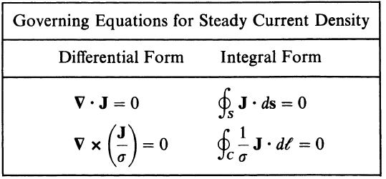
Steady currents governing equations

Slide 14




Steady currents governing equations
Normal
component
Tangential
component

Slide 15




Analogy of physics at the boundary
Dielectric
Conductor

Slide 16
Main parts in steady electric currents:
Ohm’s law
(II) Kirchoff’s law (voltage)
(III) Kirchoff’s law (current)
(IV) Joule’s law
(V) Boundary conditions for current density

Slide 17
5-1 Introduction
Charges at rest (Ch3 and Ch4); Charges in motion (Ch5)
Different types of currents
Conduction currents:
in conductors and semiconductors
electrons and/or holes
Electrolytic currents:
essentially in a liquid medium
Ions (e.g., Li-ion batteries)
Convection currents:
in vacuum or rarefied gas
electrons and/or ions

Slide 18
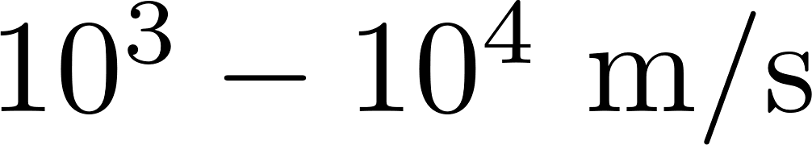
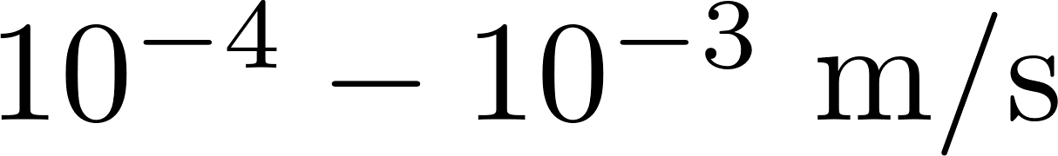
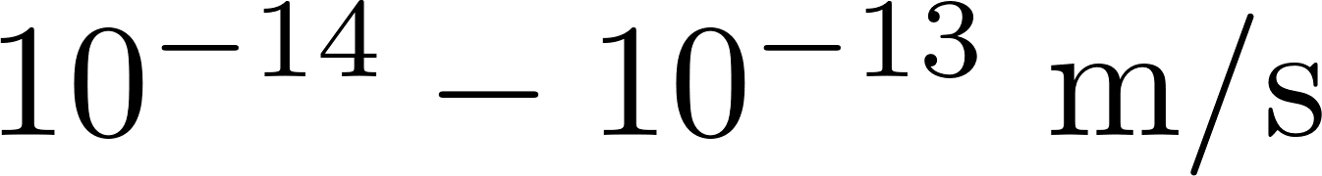
Average drift velocity of electrons for good conductors
Option | Speed in one direction | Number of votes
A |  | 20
B |  | 14
C |  | 11

Slide 19
Average drift velocity of electrons for good conductors
Option | Speed in one direction | Number of votes
A |  | 20
B |  | 14
C |  | 11

Slide 20
Topics for Conduction Currents
Point form of Ohm’s law
Kirchhoff’s voltage law
Kirchhoff’s current law
Conservation of charge
Equation of continuity
Boundary conditions for current density

Slide 21
Conduction Currents
For a conductor, atoms consist of positively charged nuclei surrounded by electrons
Inner shell: tightly bound charges
Outermost shell: loosely bound charges (valance or conduction electrons)
Without external E: conduction electrons wander randomly ➔ no net drift motion of conduction electrons

Slide 22
Conduction Currents
With external E: organized motion of conduction electrons
Very low drift velocity due to collision with atoms
Conductor remains electrically neutral (electric forces prevent excess electrons from accumulating at any point of a conductor)

Slide 23


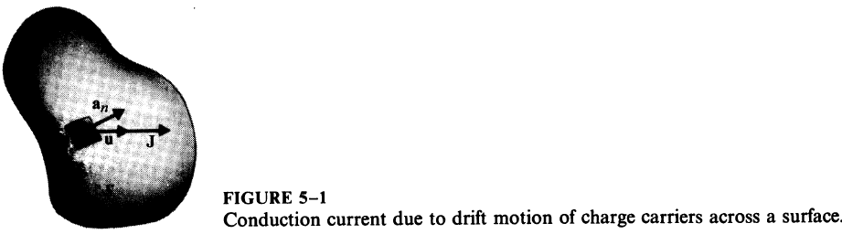


5-2 Current Density and Ohm’s Law
Charge q across surface Δs with a velocity u
N: #/volume
The amount of charge passing Δs
differential volume with Δs along a_{n}
Defined as volume current density
Δs

Slide 24

Total current I flowing through a surface S

Slide 25
Example

Slide 26
Example

Slide 27
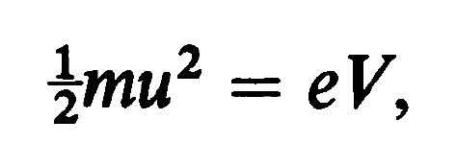
Example

Slide 28
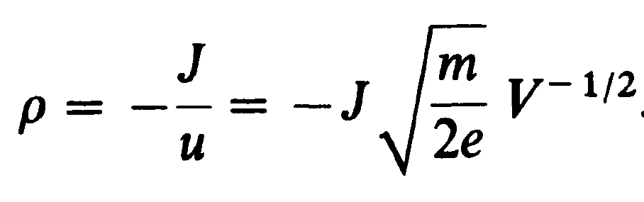

Example

Slide 29
Example

Slide 30

Example

Slide 31


Conduction Currents
For more than one kind of charge carriers (electrons, holes, and ions) drifting, current density:
For most conducting materials,
u: averaged drift velocity
−μ_{e}: electron mobility (m²/V⋅s)

Slide 32

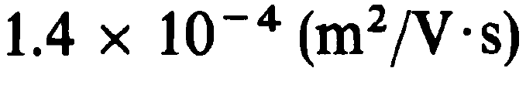
Conduction Currents
For most conducting materials,
u: averaged drift velocity
−μ_{e}: electron mobility (m²/V⋅s)

Slide 33




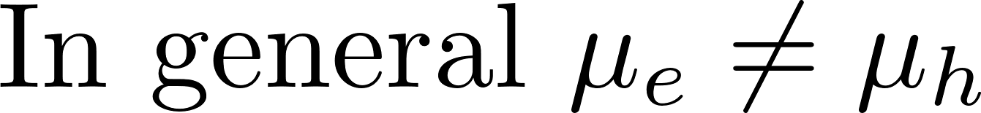
where
Such materials are called ohmic media
where
ρ_{e}<0
σ: conductivity (A/V⋅m or S/m)
For conductors,
For semiconductors,

Slide 34
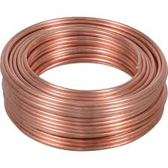
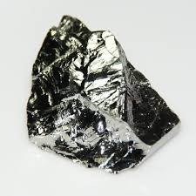




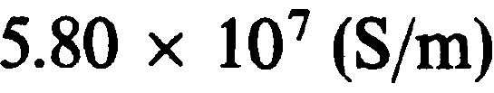
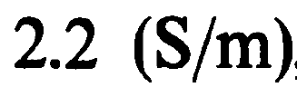
Conductivities
Votes | Right answer
Copper
Germanium
Silicon

Slide 35
Conductivities
Votes | Right answer
 | Copper
 | Germanium
 | Silicon

Slide 36

Ohm’s law
Point form of Ohm’s law
Holds at all points
σ can be a function of space
Integration?
E = (1/σ)J

Slide 37
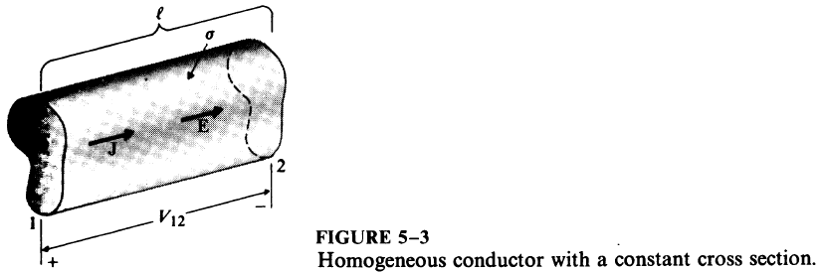







Ohm’s Law: Point Form to Circuit Form
or
S
or
The resistance

Slide 38
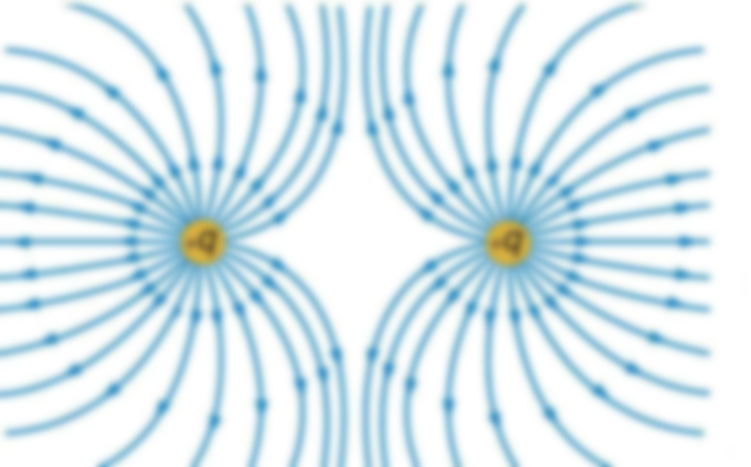
Quick classroom exercise
Break up into groups of 5 and spend 5-10 minutes working out:

Slide 39
Quick classroom exercise
Break up into groups of 5 and spend 5-10 minutes working out:

Slide 40
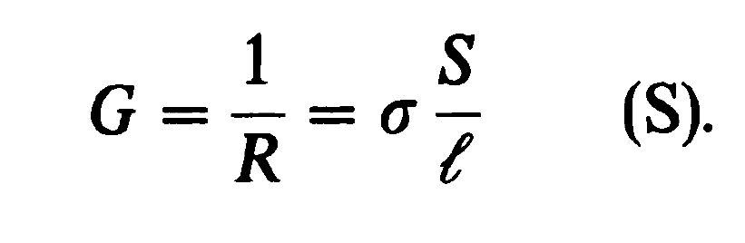
Conductance

Slide 41
Currents in closed loops
Kirchoff’s voltage law
(loop analysis)

Slide 42
Currents in closed loops
Kirchoff’s circuit law
(node analysis)

Slide 43
Ohm’s law versus Kirchoff’s circuit law
Ohm’s Law describes the relationship between voltage and current across a resistive element.
Ohm’s Law states that voltage across a conductor is proportional to the current flows through it.
Ohm’s Law is applicable to a single resistive element or set of resistive circuits as a whole.
Kirchhoff’s Law describes the behaviour of current and voltage respectively in a circuit branch.
KCL states that the sum of current flows to a node is equal to zero while KVL states that the sum of voltages in a closed loop is zero.
KCL and KVL are applicable to a series of resistive elements in a circuit.

Slide 44


5-3 Electromotive Force and Kirchhoff’s Voltage Law
For an ohmic material
A steady current cannot be maintained in the same direction in a closed circuit by an electrostatic field (conservative field)
That is, to maintain a steady current in a closed circuit, there must be non-conservative field (e.g., electric batteries, etc.), which termed as impressed electric field intensity E_{i}

Slide 45
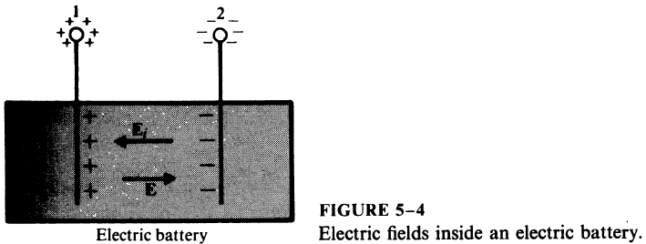
Electromotive Force
Chemical action (E_{i}) ➔ cumulation of + and − charges on electrodes due to E_{i} ➔
Inside: E and E_{i}
E = −E_{i} due to I=0 for open circuit
Outside: E only
E: electrostatic field
E_{i}: nonconservative field
Open circuit

Slide 46


Electromotive Force
Against E_{i} from 1 to 2
E_{i}
E
The electromotive force is a measure of the strength of the nonconservative source, not a force
Open circuit: E_{i}=−E
Because of conservative field
Open circuit

Slide 47


or
emf = voltage rise between + and − terminals
Open circuit

Slide 48
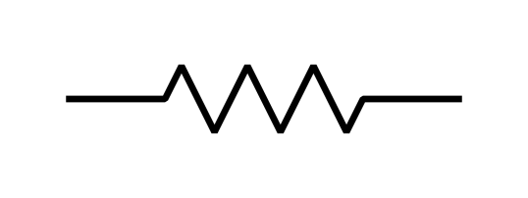

Open circuit ➔ No currents
If connected with a resistor
➔ Currents
Point form of Ohm’s law

Slide 49


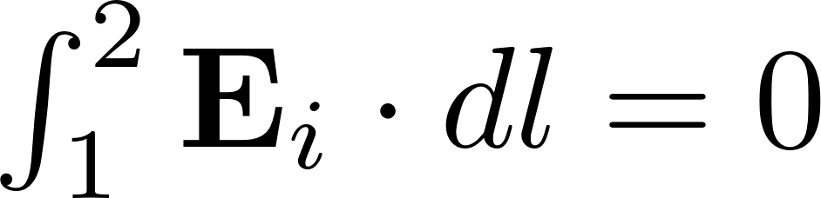
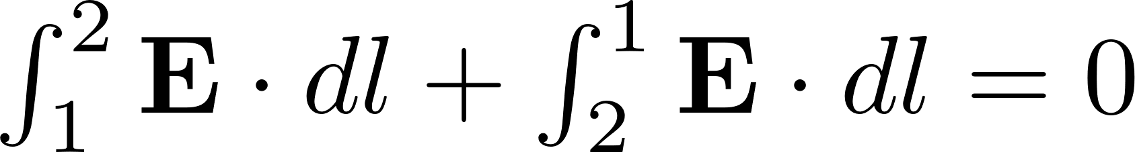

Integration due to 1st integrand = 0
Integration due to E_{i} outside the source = 0
For a resistor with uniform cross section:

Slide 50

For more-than-one emf and more-than-one resistor connected in series
Kirchhoff’s voltage law: around a closed path in an electric circuit, the algebraic sum of the emf’s (voltage rises) is equal to the algebraic sum of the voltage drops across the resistances

Slide 51
Currents in closed loops
Kirchoff’s circuit law
(node analysis)

Slide 52


5-4 Equation of Continuity and Kirchhoff’s Current Law
Principle of conservation of charge: electric charges may not be created or destroyed
Current leaving a volume
Rate of charge decrease in the volume

Slide 53

Holds for arbitrary volume V
Equation of continuity

Slide 54




For steady current (I=constant), charge density does not vary with time (or charge in a volume is a constant over time although charge is moving):
- - - - - - - - - - - -
- - - - - - - - - - - -
(divergenceless: streamlines of steady currents close upon themselves)
(integral form)
closed S →0;
That is, volume (enclosed by S) → 0
Kirchhoff’s current law: the algebraic sum of all the currents flowing out of a junction (a small volume) in an electric circuit is zero.

Slide 55
E and ρ inside a Conductor: time to equilibrium
+
+
+
+
ρ_{inside}=0
+
+
Conductor surface
Charge distribution due to electrostatic force
By Gauss’s law

Slide 56

Time to Reach Equilibrium in a Conductor
Inside a conductor, ρ=0, E=0 under equilibrium conditions
Time to reach equilibrium?
Equation of continuity
Assume a constant σ

Slide 57




In a simple medium
Solution:
Charge density inside a conductor will decrease with time exponentially.
Relaxation time: time for ρ₀ to decay to 1/e

Slide 58
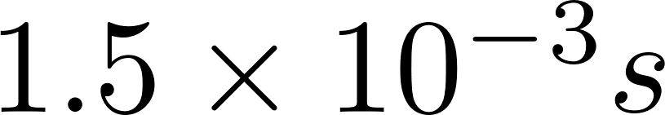
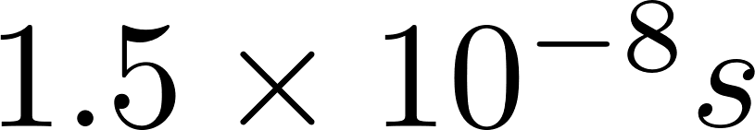
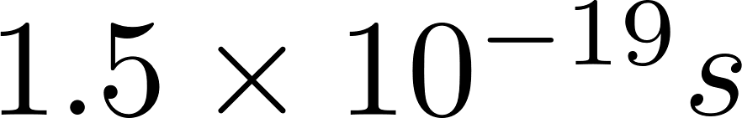
Relaxation time for copper
Relaxation time: time for ρ₀ to decay to 1/e
Option | Speed in one direction | Number of votes
A
B
C

Slide 59

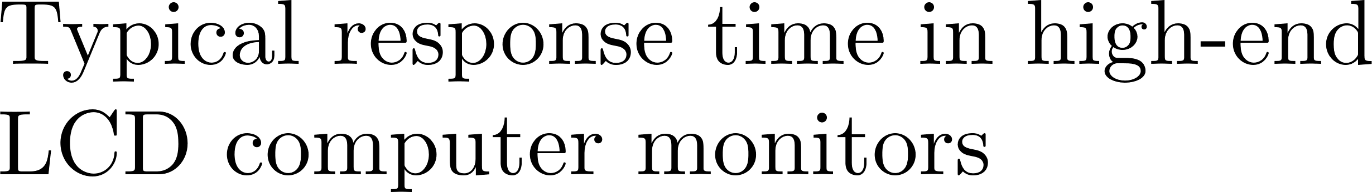
Relaxation time for copper
Relaxation time: time for ρ₀ to decay to 1/e
Option | Speed in one direction | Number of votes
A

Slide 60
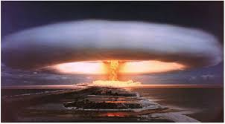
Relaxation time for copper
Relaxation time: time for ρ₀ to decay to 1/e
Option | Speed in one direction | Number of votes
B

Slide 61
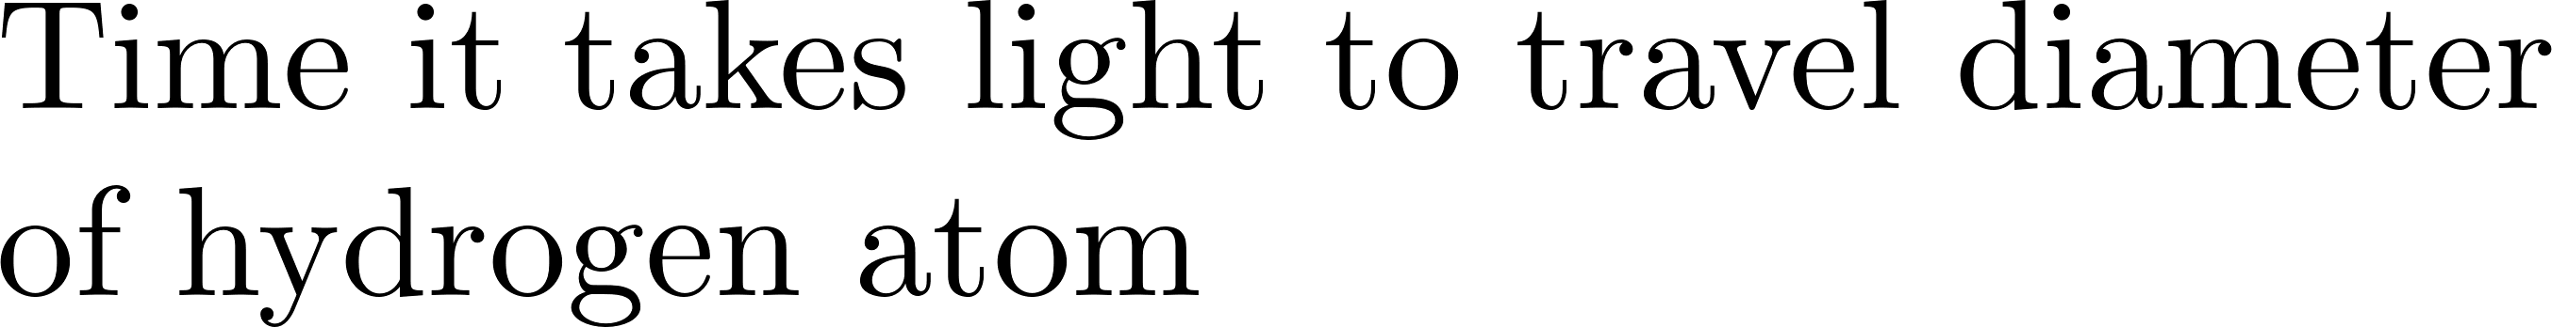

Relaxation time for copper
Relaxation time: time for ρ₀ to decay to 1/e
Option | Speed in one direction | Number of votes
C

Slide 62
Relaxation time for copper
Relaxation time: time for ρ₀ to decay to 1/e
Option | Speed in one direction | Number of votes
A
B
C

Slide 63
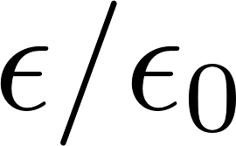
Relaxation times
Relaxation time: time for ρ₀ to decay to 1/e
CHARGE RELAXATION TIMES OF TYPICAL MATERIALS
 | Conductivity |  | Relaxation time s
Water, distilled | 2 x 10⁻⁴ | 81 | 3.6 x 10⁻⁶
Corn oil | 5 x 10⁻¹¹ | 3.1 | 0.55
Mica | 10⁻¹¹ - 10⁻¹⁵ | 5.8 | 5.1 - 5.1 x 10⁴

Slide 64
Main parts in steady electric currents:
Ohm’s law
(II) Kirchoff’s law (voltage)
(III) Kirchoff’s law (current)
(IV) Joule’s law
(V) Boundary conditions for current density

Slide 65


5-5 Power Dissipation and Joule’s Law
Power dissipation:
External E ➔ drift motion of electrons, which collide with atoms on lattice sites ➔ thermal energy
Power by E to move a charge q
u: drift velocity
Total power in a volume dv
Total Q in a volume dv

Slide 66



Power density
Joule’s law

Slide 67

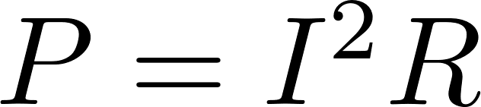
In a conductor with constant cross section
We get the familiar expression

Slide 68
Main parts in steady electric currents:
Ohm’s law
(II) Kirchoff’s law (voltage)
(III) Kirchoff’s law (current)
(IV) Joule’s law
(V) Boundary conditions for current density

Slide 69
5-6 Boundary Conditions for Current Density
Steady current density J on boundaries without nonconservative energy source

Slide 70



Chapter 3
Here
The normal component of a divergenceless vector field is continuous
The tangential component of a curl-free vector field is continuous across an interface
The ratio of J_{t} at two sides of an interface is equal to the ratio of the conductivities

Slide 71


Example

Slide 72
Example

Slide 73
Example

Slide 74
Example

Slide 75
Example

Slide 76
Chapter 3
Here
The normal component of a divergenceless vector field is continuous
The tangential component of a curl-free vector field is continuous across an interface
The ratio of J_{t} at two sides of an interface is equal to the ratio of the conductivities

Slide 77
∇×(D/ε)=0
Analogy
Interface of dielectric media
Interface of conducting media
D
J
ε
σ

Slide 78




A homogeneous conducting medium
Electrostatics analogy
If σ is a constant (homogeneous)
∇×E=0
By null identity
E=−∇V
Laplace’s eq.:
∇²V=0
J=σE

Slide 79


Boundary Condition between Two Lossy Dielectrics (for a Steady Current)
Two lossy dielectrics:
J_{1t}/σ₁=J_{2t}/σ₂
In most cases, a surface charge exists at the interface unless σ₂/σ₁=ε₂/ε₁
What if medium 2 is a perfect conductor?

Slide 80
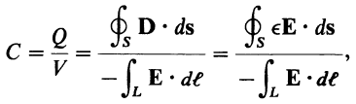
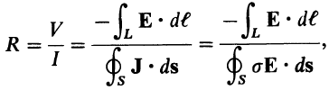
5-7 Resistance Calculations
Capacitance between two conductors:
Q
E
L
−Q
Numerator: surface integral over a surface enclosing the positive conductor
Resistance between two conductors (medium between is lossy):
J
L
Denominator: the same surface as in the numerator of the above equation

Slide 81
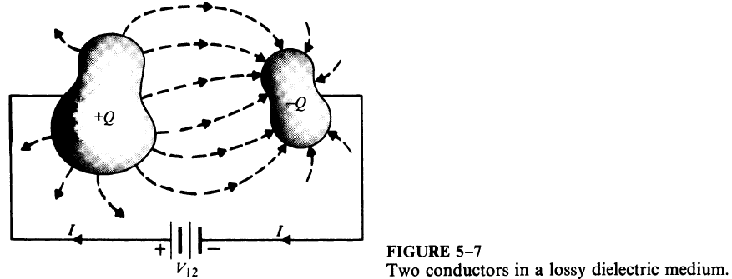

Slide 82

×
If ε and σ of the medium have the same space dependence or if the medium is homogeneous

Slide 83
C_{l} and R_{l}
C_{l}: capacitance per unit length
C_{l} = C/l (F/m)
(l longer → area S larger → C larger)
l: in/out plane direction
Q
C=εS/d
−Q
R_{l}: Resistance per unit length
R_{l} = Rl (Ω⋅m)
(l longer → area S larger → R smaller)
l: in/out plane direction
J
L
R=εL/S
Note that l and L are different!
R_{l}C_{l}=ε/σ

Slide 84

Procedure to Compute R between Specified Equi-potential Surfaces
Procedure 1: V₀ to I
1. Choose a coordinate
2. Assume potential difference V₀ between conductors
3. Find E between conductors
∇²V=0 ➔ E=−∇V
4. Find current
5. Find R=V₀/I
Procedure 2: I to V₀
Assume I ➔ J ➔ E ➔V₀
R=V₀/I
if J can be determined easily from I

